Slide 1
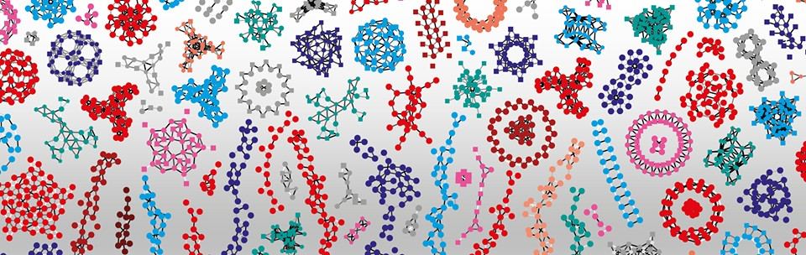

Generalized Additive Models
Rachel Jeitziner
Bioinformatics Scientists @ the Bioinformatics Core Facility Aug 19, 2021 - Lausanne

Slide 2
Local regression

Slide 3
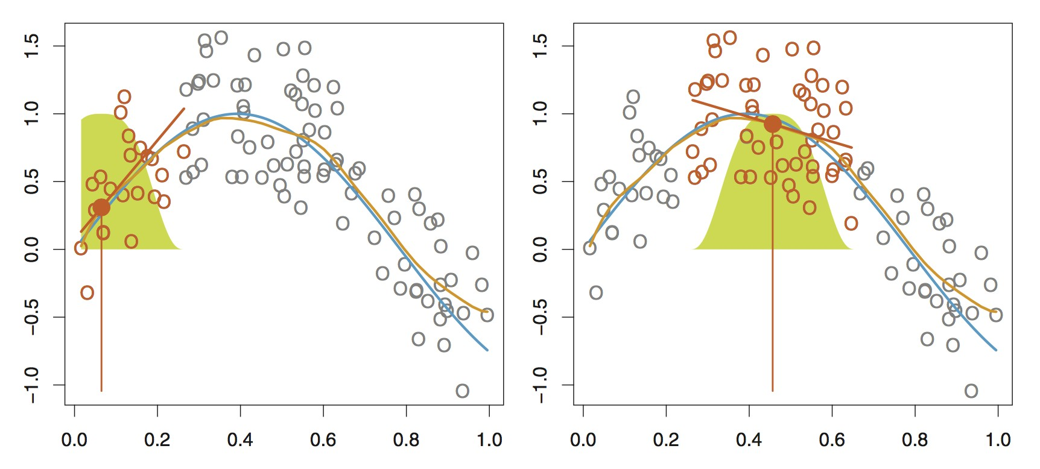
Local Regression
Local regression is a different approach for fitting flexible nonlinear functions, which involves computing the fit at a target point x₀ using only the nearby training observations

Slide 4
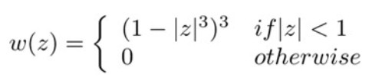
Local Regression
In order to perform local regression, there are a number of choices to be made, such as:
how to define the weighting function
whether to fit a constant, linear, quadratic regression, etc.
The most important choice is the “span”. The span plays a role like that of the tuning parameter λ in smoothing splines: it controls the flexibility of the non-linear fit
The smaller the value of s, the more local and wiggly will be our fit; alternatively, a very large value of s will lead to a global fit to the data using all of the training observations
In R via stats::loess or its ancestor stats::lowess
Multivariate (up to 4 predictors)
By default fits polynomial degree 2
– Using tricubic weighting
4

Slide 5
Generalized Additive Models (GAMs)
So far, we have seen a number of approaches for flexibly predicting a response Y on the basis of a single predictor X
Here we explore the problem of predicting Y on the basis of several predictor X1, X2, …, Xp
GAMs provide a general framework for extending a standard linear model by allowing smooth functions of each of the variables, while maintaining additivity
– The response can be either quantitative or qualitative

Slide 6

Generalized Additive Models (GAMs)
A natural way to extend the multivariable linear regression model
in order to allow for smooth relationships between each feature and the response is to replace each linear component with a smooth function:
This is an example of a GAM
It is called additive model because we calculate a separate f_{j} for each X_{j}, and then add together all of their contributions
The beauty of GAMs is that we can use various smoothing methods as building blocks for fitting an additive model
Spline regression
Smoothing splines
Local regression (loess)

Slide 7
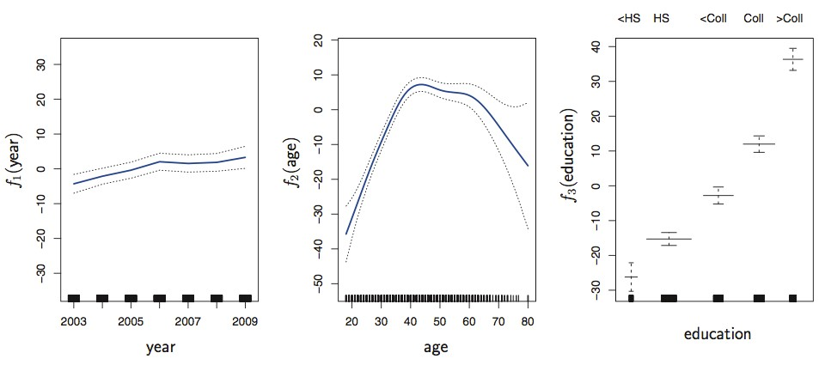
smoothing splines

Slide 8
Fitting GAMs
To fit a GAM using smoothing splines and local regression
Coefficients not that interesting; fitted functions are
Can mix terms (linear or nonlinear) and use anova(…) to compare models

Slide 9
Fitting GAMs
The gam package in R uses an approach known as backfitting
Involves repeated updating of the fit for each predictor while holding others fixed
Each time we update a function, we simply apply the fitting method for that variable to a partial residual
A partial residual for X₃ for example, has the form r_{i} = y_{i}- f₁(x_{i1}) – f2(x_{i2}) and therefore If we know f₁ and f₂ then we can fit f3 by treating this resudal as a response in a smooth regression on X₃
The mgcv package in R uses mixed modeling framework for smoothing

Slide 10
Fitting GAMs
GAMs allow us to fit a smooth f_{j} to each X_{j}, so that we can automatically model non-linear relationships that standard linear regression will miss
– This means we do not need to manually try many different transformations on each variable independently
The smooth fits can potentially make more accurate predictions for the response Y
Because the model is additive, we can still examine the effect of each Xj on Y individually while holding all of the other variables fixed
10

Slide 11
Smoothing Exercise: The “wage” data
Mid-Atlantic Wage Data
– Wage and other data for a group of 3000 workers in the Mid-Atlantic region

Slide 12
References
Semiparametric Regression; by David Ruppert, M.P. Wand, and R.J. Carroll; Cambridge University Press
Generalized Additive Models; by T.J. Hastie and R.J. Tibshirani; Chapman & Hall/CRC
Generalized Additive Models - An Introduction with R (2nd Edition); by Simon N. Wood; CRC Press

